Slide 1
Quantum Computing
Yang Liu
Ph.D. Candidate of Computer Science
Human-Centered AI (HCAI) Lab
Quantum Computing Research Center <QC|RC>
Advisor: Dr. Mohd Anwar
Professor of Computer Science
Director, Quantum Computing Research Center
Director, Human-Centered AI (HCAI) Lab
Director, Center for Advanced Studies in Identity Sciences

Slide 2
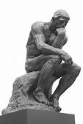
If quantum computing is the wave of the future, what do I need to do to ride this wave? Seek to understand the world of quantum and separate the hype from reality.

Slide 3
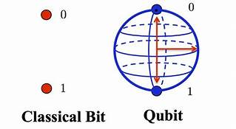
Bit, Qbit
Classical Computing
Bit - binary digit (0, 1), represents a logical state with one of two possible values.
Quantum Computing
Qubit - A ‘qubit’ is a ‘quantum bit’ (|0> , |1>).

Slide 4
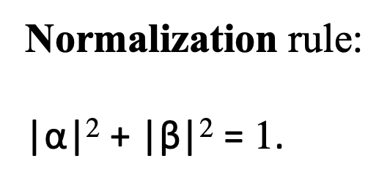
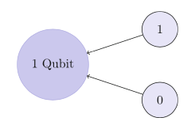
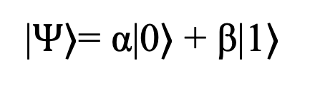
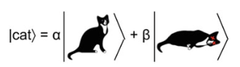
Dirac Bra-Ket Notation
“Ket”: the state of a qubit is enclosed in the right half of an angled bracket
A classical bit can be either 0 or 1. A qubit can be in a superposition of both 0 and 1
The state of Schrödinger’s cat expressed in bra-ket notation
Notes:
|$Ψ$⟩= α|0⟩ + β|1⟩,
A qubit, |⟩, could be in a |0⟩ or |1⟩ state or even a superposition of both |0⟩ and |1⟩.
with α and β called the amplitudes of the states
Amplitudes are generally complex number

Slide 5
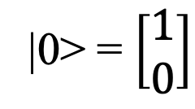
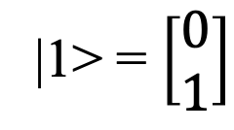
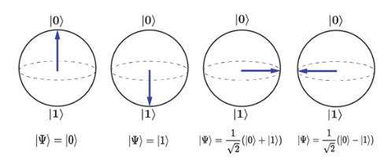
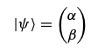
Bloch Sphere
A qubit is written as a two-dimensional vector where the amplitudes are the components of the vector :
A single qubit can be visualized using the Bloch sphere.
Each point on the Bloch sphere corresponds to a different possible superposition of a single qubit.
Notes:
Fig. The state of a qubit is represented by an arrow on the Bloch sphere

Slide 6
Single-Qubit Gates

Slide 7
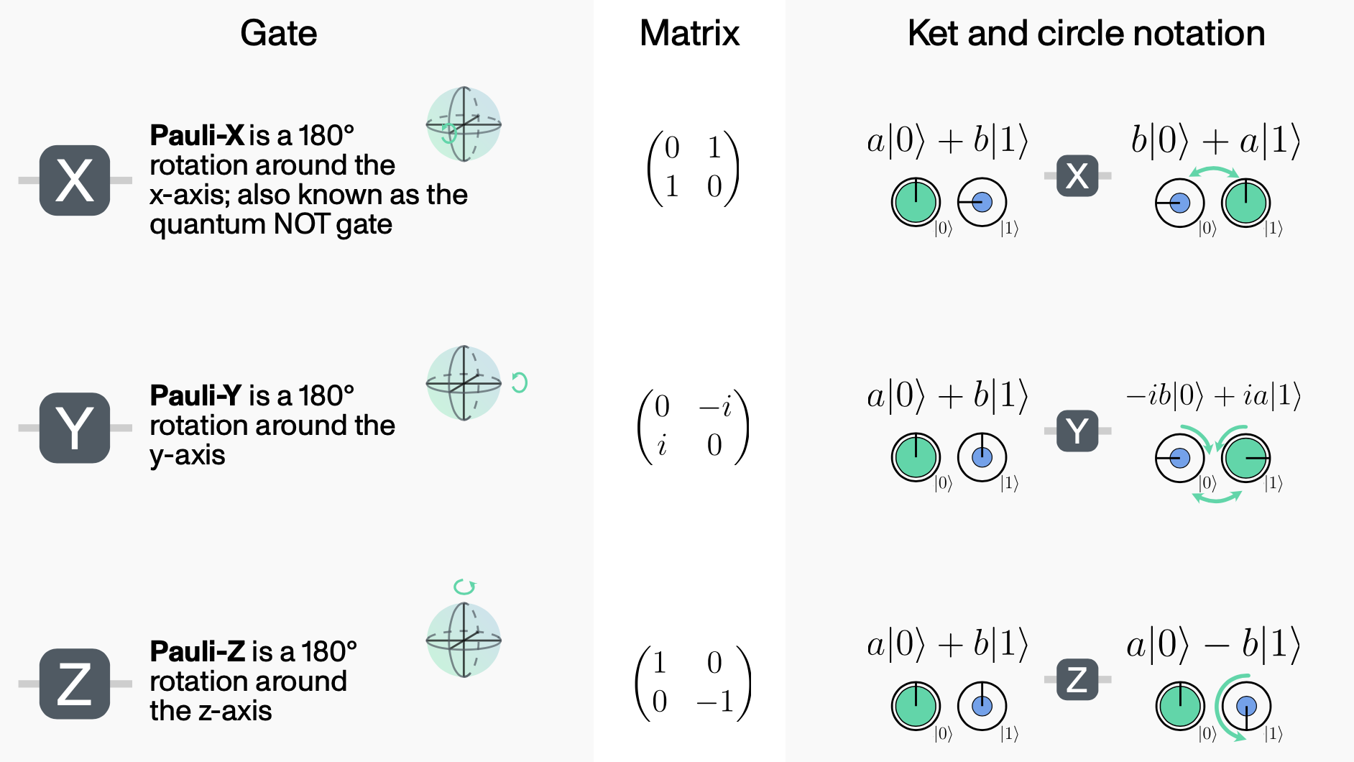

Slide 8
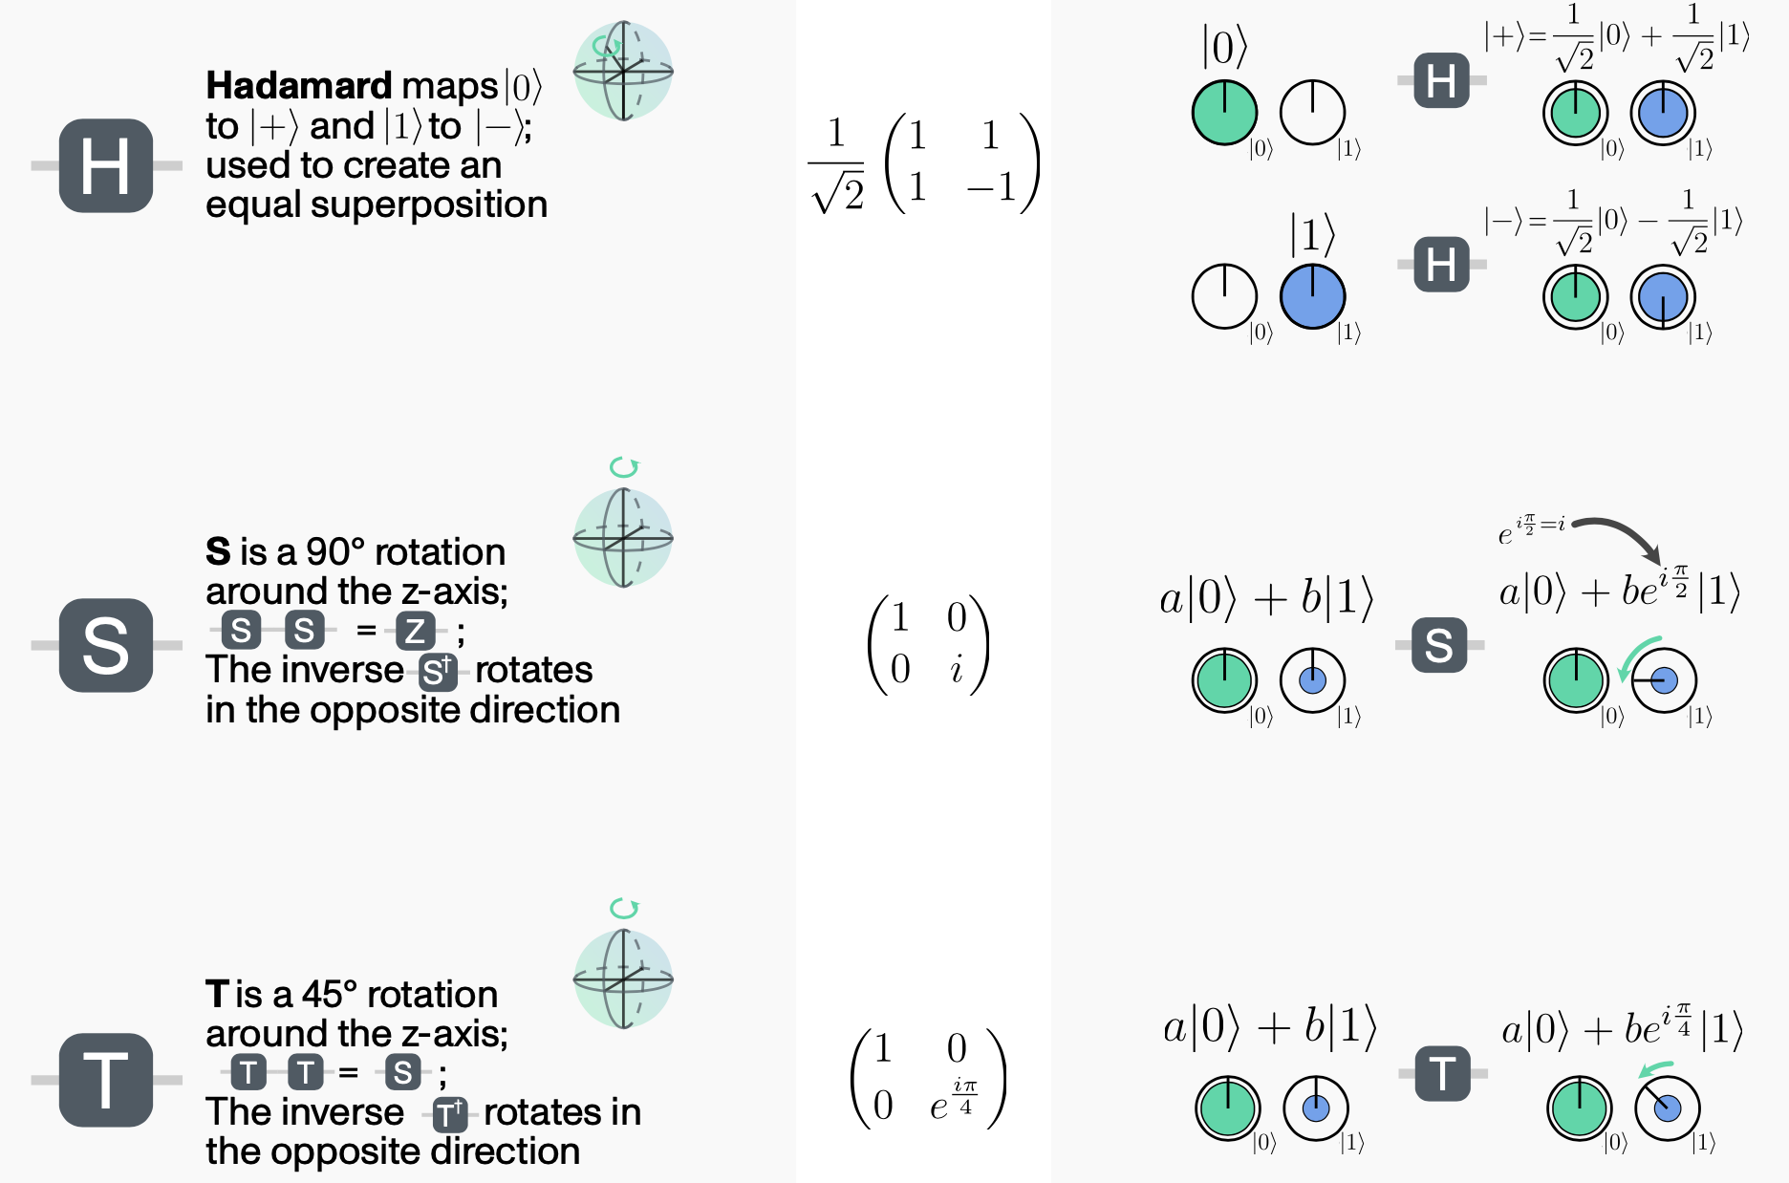

Slide 9
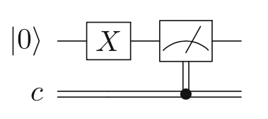
Pauli-X gate
maps |0> to |1> and |1> to |0>.
Applying the X gate on the IBM Q simulator and measuring the output
Notes:
Fig. 6.1 Applying the X gate on the IBM Q simulator and measuring the output

Slide 10
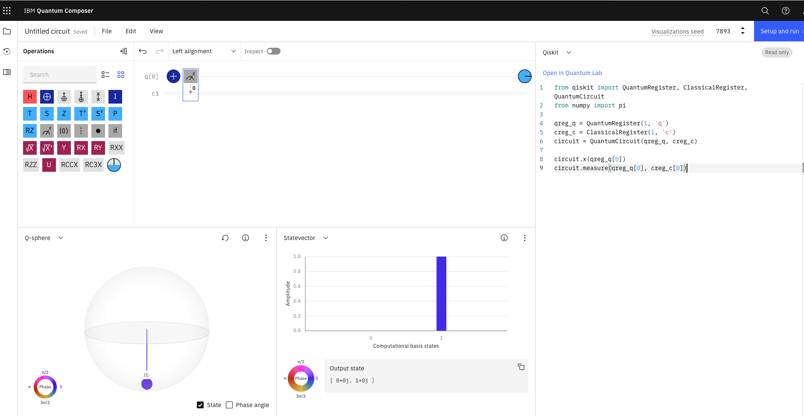
Apply a NOT gate on single qubit

Slide 11
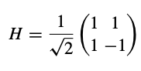
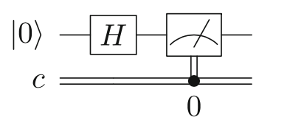
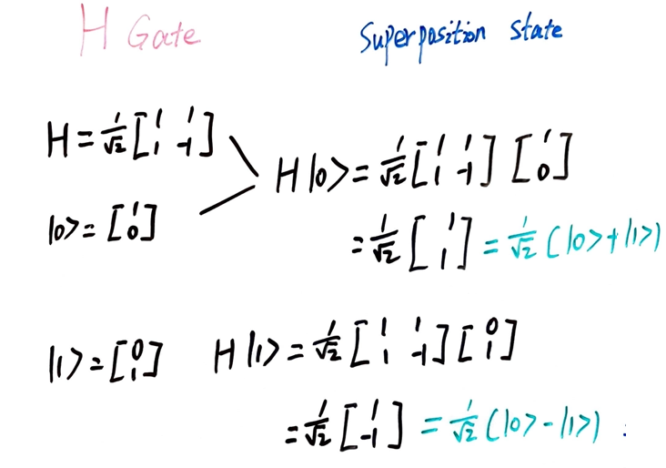
Hadamard Gate
If the qubit starts in a definite |0⟩ or |1⟩ state, the Hadamard gate puts each into a superposition of |0⟩ and |1⟩ states.
Applying the H gate on the IBM Q simulator and measuring the output

Slide 12
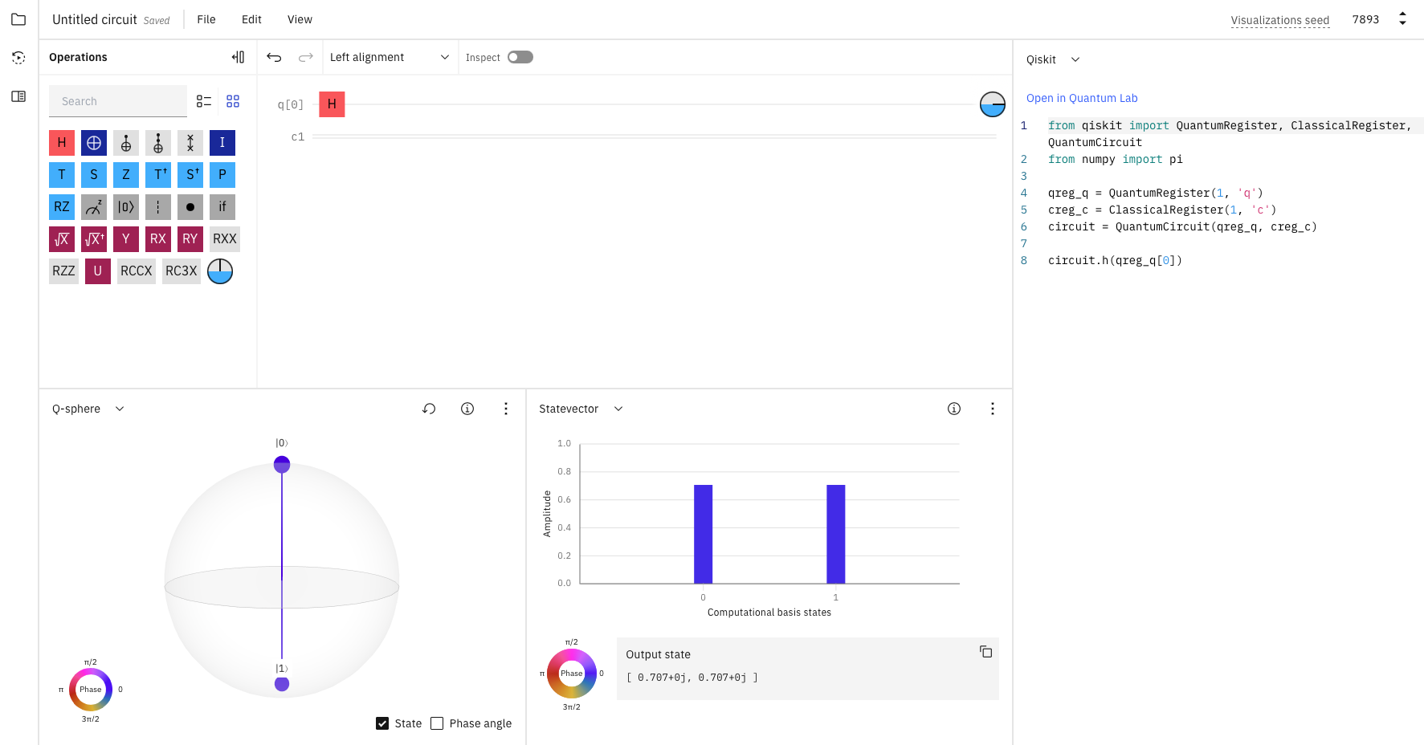
Apply a H gate on single qubit without Measurement

Slide 13
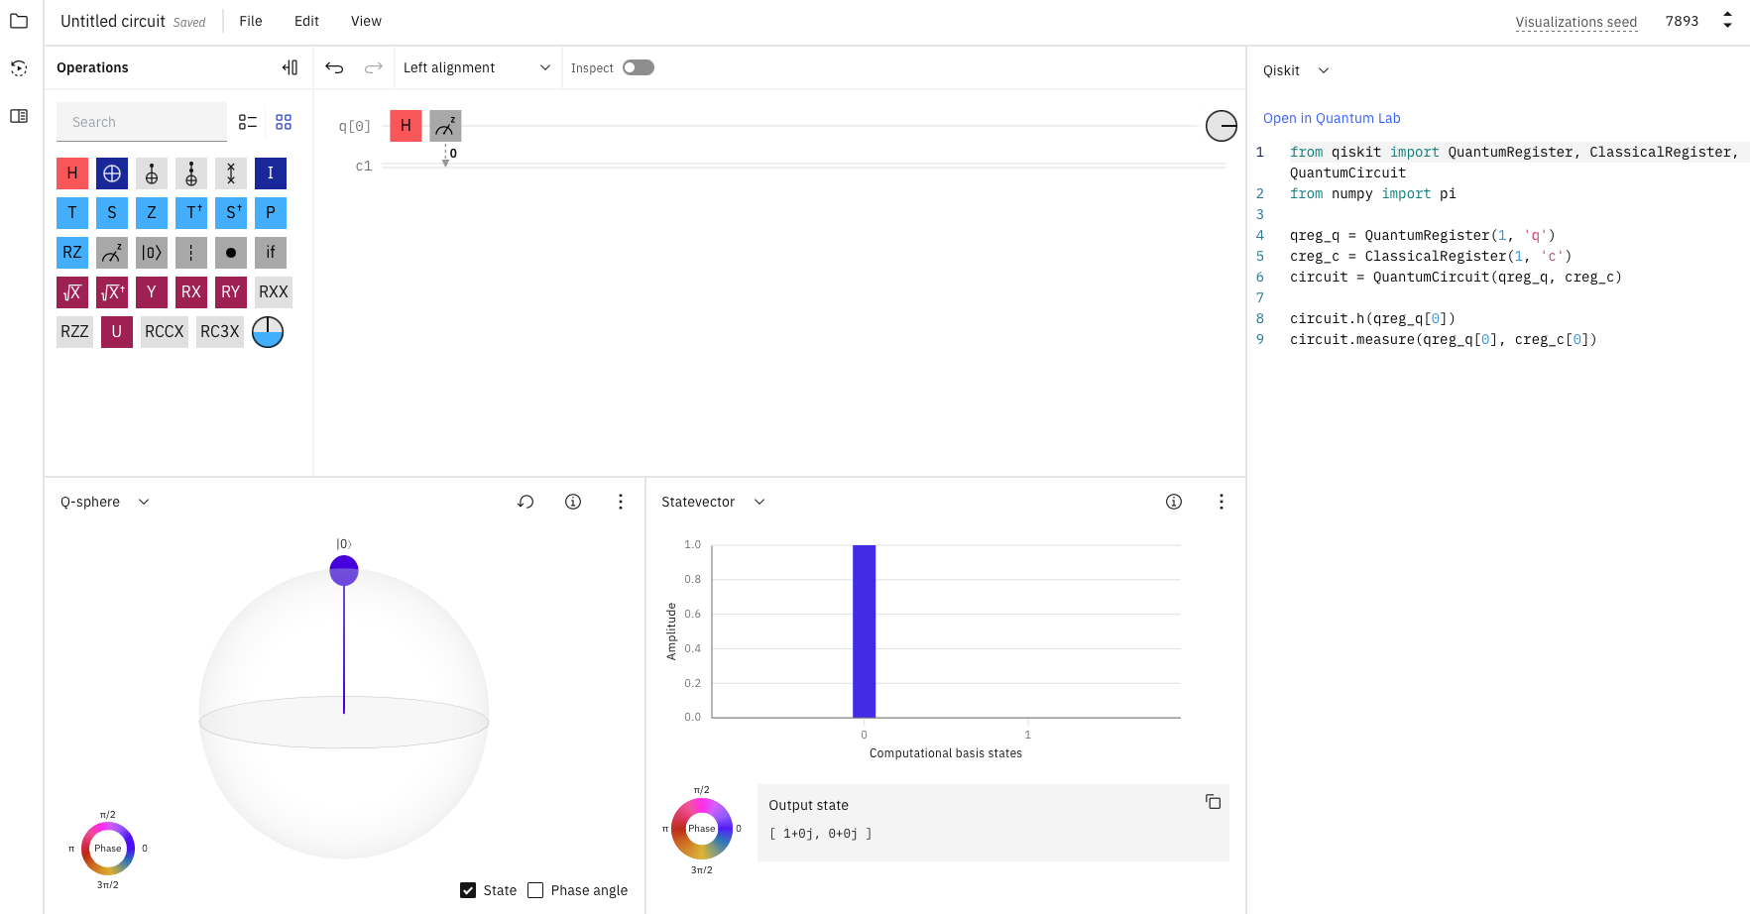
Apply a H gate on single qubit with Measurement

Slide 14
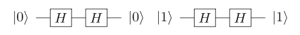
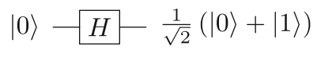
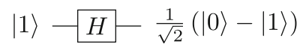
How can we tell what the initial state was after a Hadamard operation?
The way to measure and distinguish between them is to add a second Hadamard gate.
If the initial state is |0⟩, the Hadamard gate will create the superposition state called the |+⟩;
If the initial state is |1⟩, the Hadamard gate will create the superposition state called the |-⟩;

Slide 15
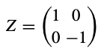
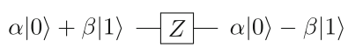
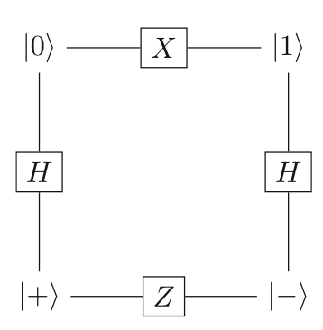
Z Gate
leaves a |0⟩ state unchanged but flips the sign of the |1⟩ state to −|1⟩
The X, H, and Z gates change the qubit’s state in the z- and x-basis and are related according to this diagram.

Slide 16
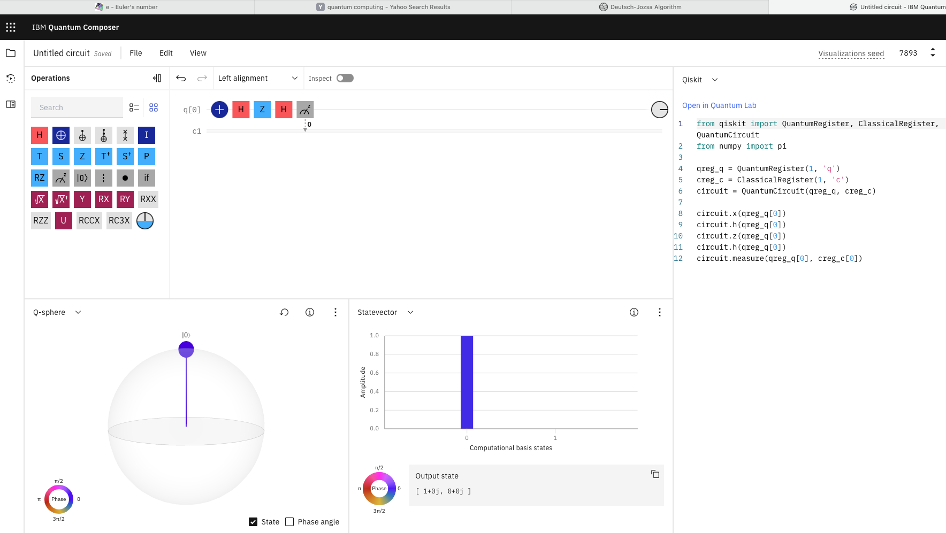
Apply X-H-Z-H gate on single qubit with Measurement

Slide 17
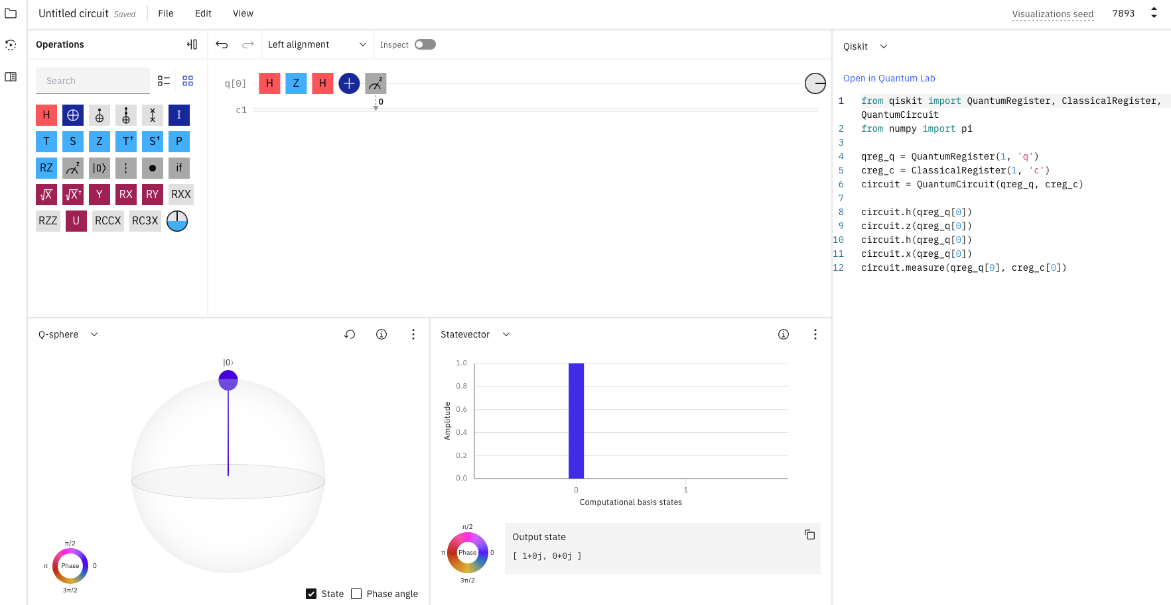
Apply H-Z-H-X gate on single qubit with Measurement

Slide 18
Big Ideas
Every interaction with a classical computer is caused by code instructing classical logic gates to operate on classical bits.
Similarly, a calculation on a quantum computer is caused by coding quantum logic gates to act on qubits.

Slide 19
Multi-Qubit Gates

Slide 20
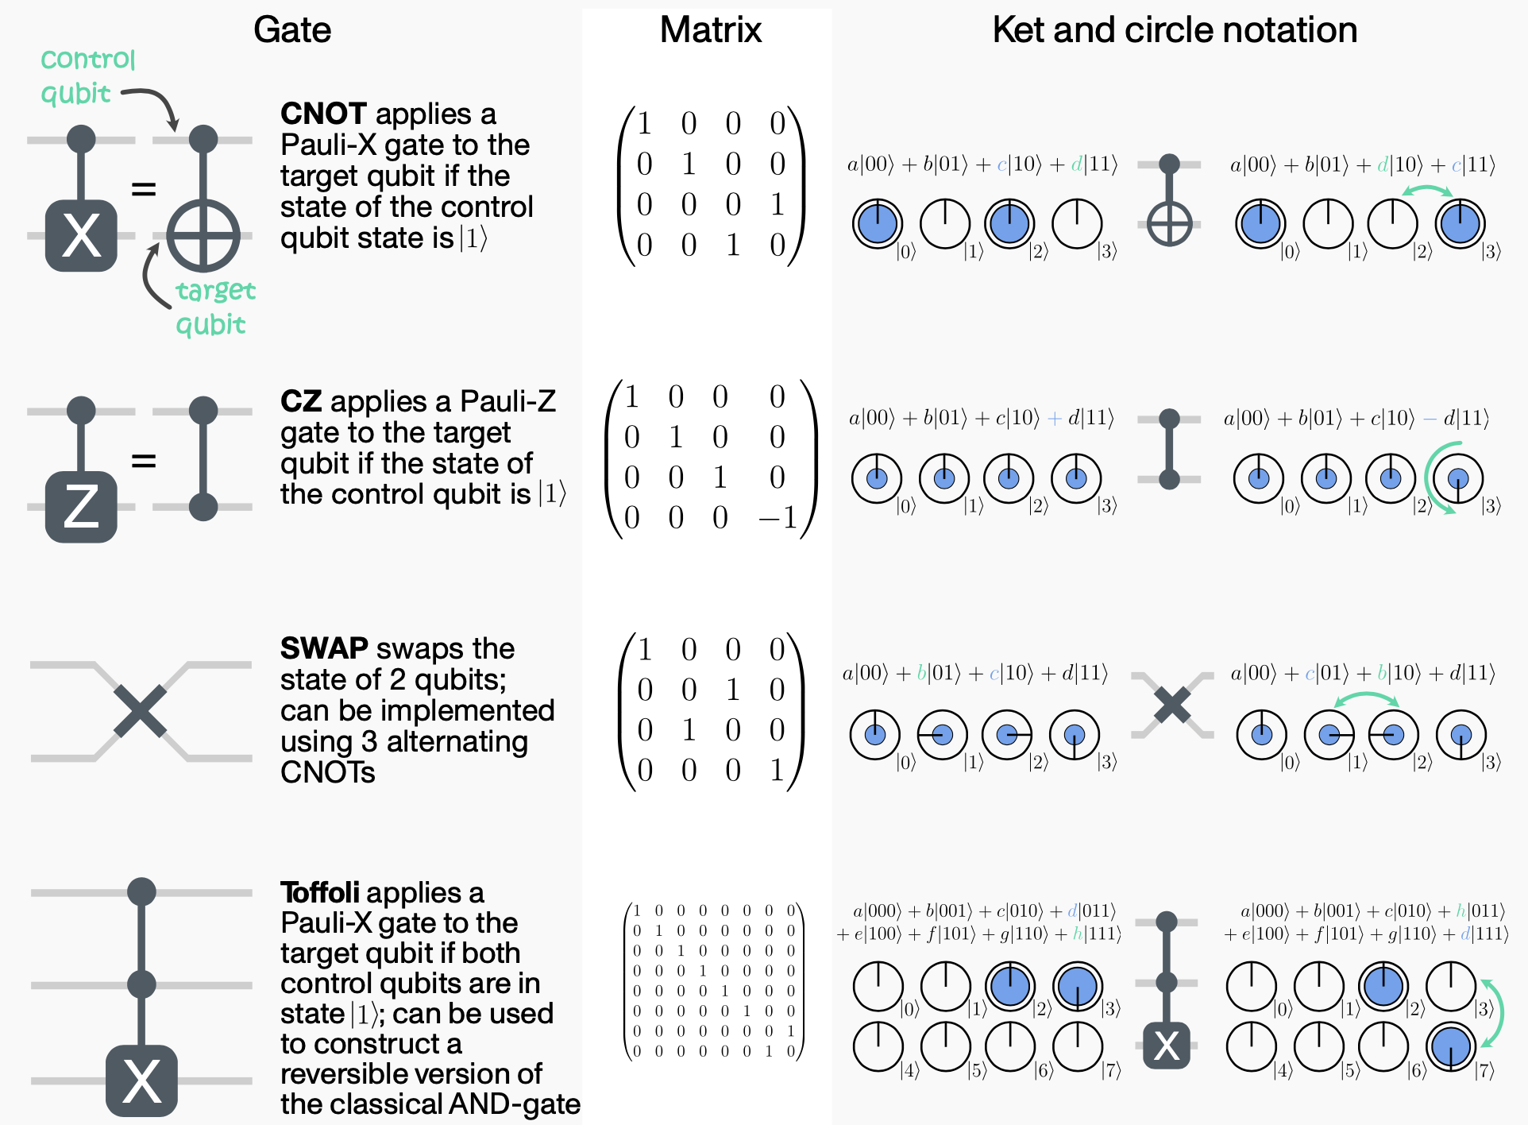

Slide 21
Qiskit

Slide 22

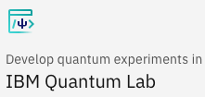
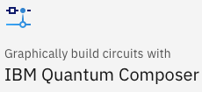
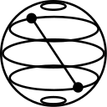
Qiskit [kiss-kit]
Qiskit is an open-source software development kit (SDK) for working with quantum computers at the level of pulses, circuits, and application modules. https://qiskit.org
Learn Quantum Computation using Qiskit
https://qiskit.org/textbook/preface.html
To install Qiskit locally, you will need Python 3.7+.

Slide 23
Anaconda Distribution
Python and all its important packages are available in the Anaconda distribution—https://www.continuum.io/
Install the Python 3.7 version
User Guide: https://conda.io/projects/conda/en/latest/user-guide/
Getting started (“test drive,” inside User Guide):
https://conda.io/docs/user-guide/getting-started.html
See especially “Getting started with Navigator”: http://docs.anaconda.com/anaconda/navigator/getting-started/

Slide 24
Jupyder Notebook
What is Jupyter ?
A rough acronym for: Julia, Python, and R.
An interactive programming environment, styled like a notebook.
Similar to Mathmatica or Maple Notebooks
Many languages supported:
https://github.com/jupyter/jupyter/wiki/Jupyter-kernels
Parts
Kernel – the compute engine (interpreter)
Dashboard – where the user interacts, usually a browser

Slide 25
What happens when I run Jupyter?
2 Things happen when you run Jupyter
The Jupyter processing engine (kernel) starts as a server on your machine
A web service listening on port 8888
http://localhost:8888
Jupyter opens a web browser window connecting to the local Jupyter server
Shows you the welcome screen

Slide 26
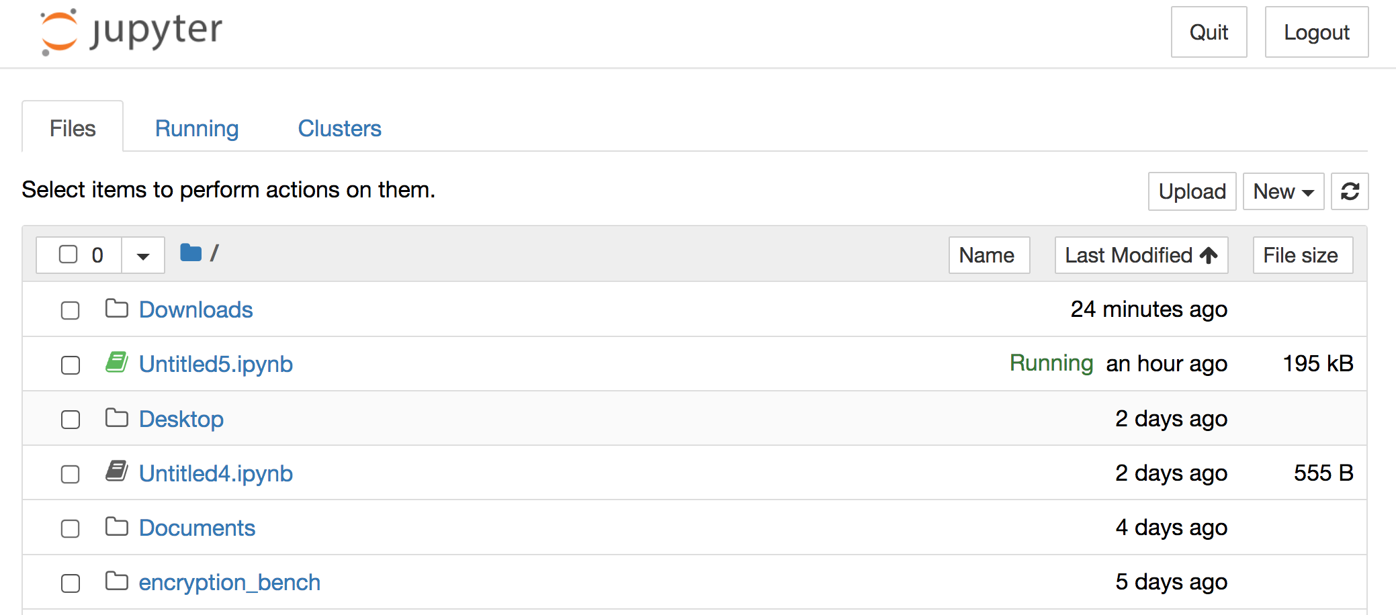
Jupyter start screen

Slide 27
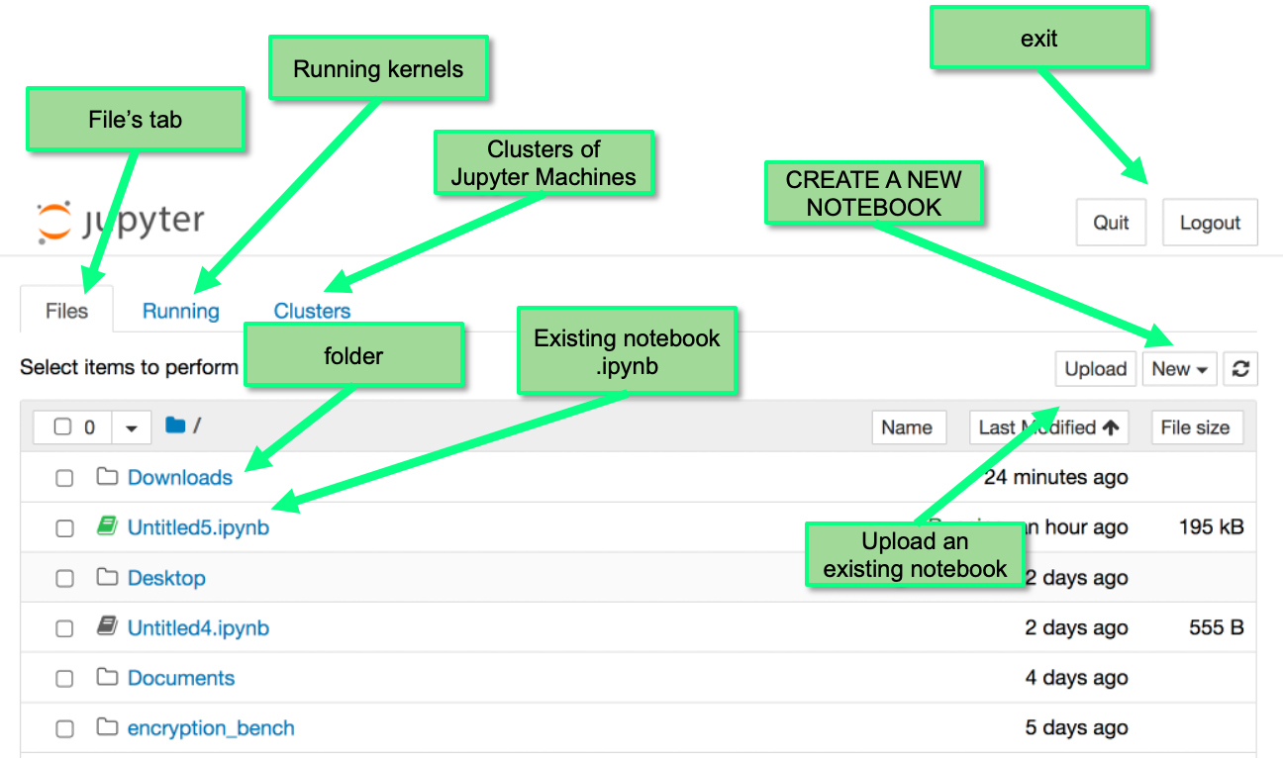
Jupyter start screen

Slide 28
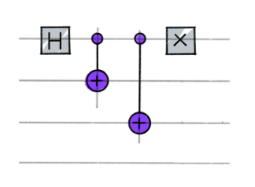
Qiskit Installation
Linux
pip install -U pip && pip install qiskit
Mac
pip install qiskit
Windows
pip install qiskit

Slide 29
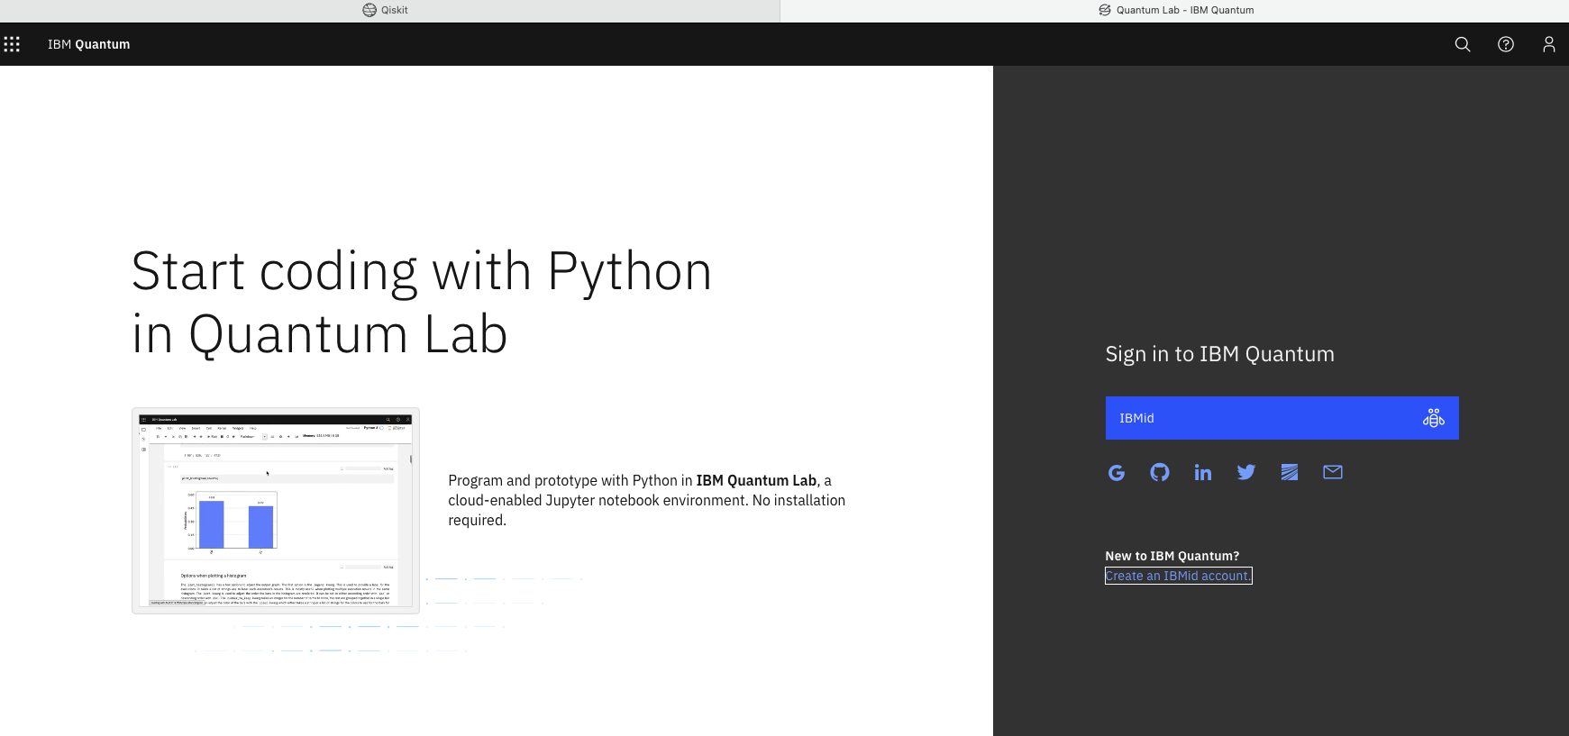
Start Online
Get started in the cloud without installing anything with IBM Quantum Lab. https://lab.quantum-computing.ibm.com/lab

Slide 30
Introduction to Qiskit
When using Qiskit a user workflow nominally consists of following four high-level steps:
Build: Design a quantum circuit(s) that represents the problem you are considering.
Compile: Compile circuits for a specific quantum service, e.g. a quantum system or classical simulator.
Run: Run the compiled circuits on the specified quantum service(s). These services can be cloud-based or local.
Analyze: Compute summary statistics and visualize the results of the experiments.

Slide 31
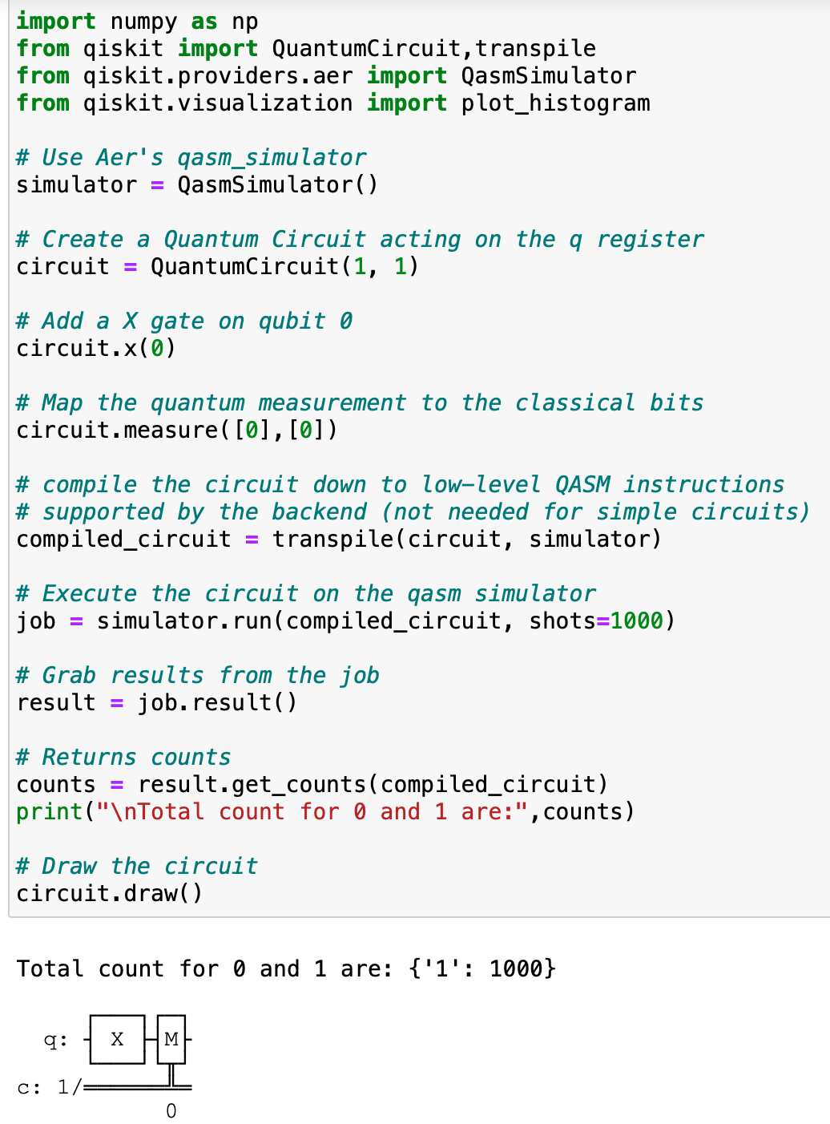
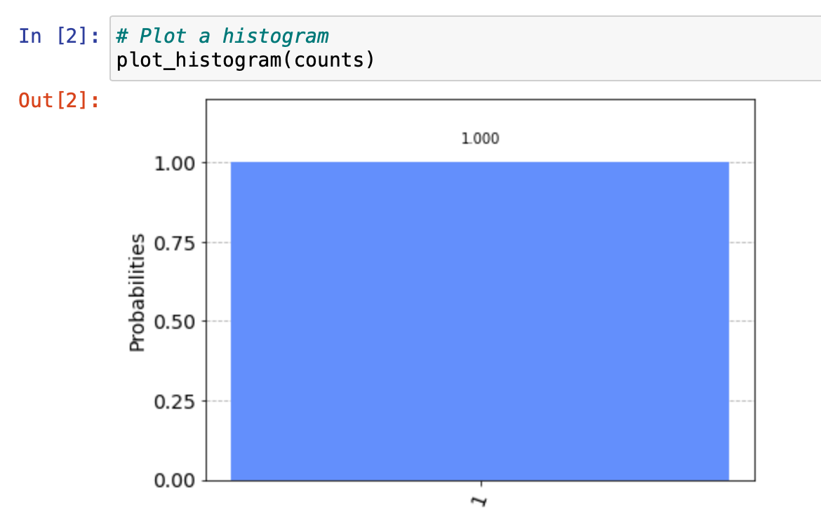
Example
Notes:
Here is an example of the entire workflow, with each step explained in detail in subsequent sections:

Slide 32
Workflow Step–by–Step
The program above can be broken down into six steps:
Import packages
Initialize variables
Add gates
Visualize the circuit
Simulate the experiment
Visualize the results

Slide 33
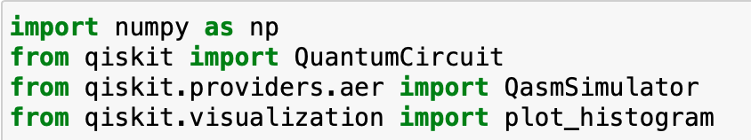
Step 1: Import Packages
The basic elements needed for your program are imported as follows:
In more detail, the imports are
QuantumCircuit: can be thought as the instructions of the quantum system. It holds all your quantum operations.
QasmSimulator: is the Aer high performance circuit simulator.
plot_histogram: creates histograms.

Slide 34
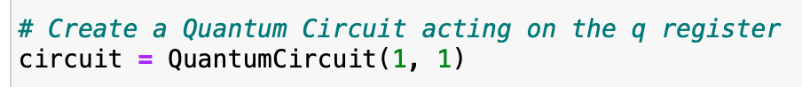
Step 2: Initialize Variables
Consider the next line of code
Here, we are initializing with 1 qubits in the zero state; with 1 classical bits set to zero; and circuit is the quantum circuit.
Syntax:
QuantumCircuit(int, int)

Slide 35
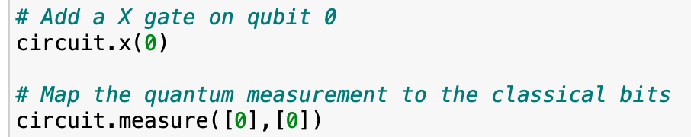
Step 3: Add Gates
We can add gates (operations) to manipulate the registers of our circuit.
Consider the following two lines of code:
The code above applies the following gates:
circuit.x(0): A Not operation (NOT) on qubit 0.
circuit.measure([0], [0]): if we pass the entire quantum and classical registers to measure, the ith qubit’s measurement result will be stored in the ith classical bit.

Slide 36
Step 4: Visualize the Circuit
We can use qiskit.circuit.QuantumCircuit.draw() to view the circuit that wee have designed in the various forms used in many textbooks and research articles.
In this circuit, the qubits are ordered with qubit zero at the top and qubit one at the bottom. The circuit is read left-to-right, meaning that gates which are applied earlier in the circuit show up farther to the left.

Slide 37
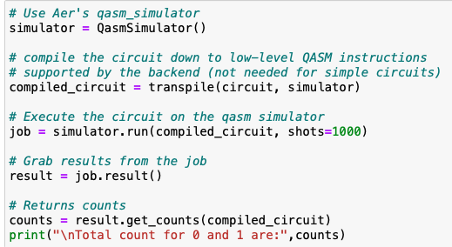
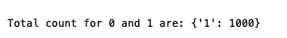
Step 5: Simulate the Experiment
Qiskit Aer is a high-performance simulator framework for quantum circuits. To simulate this circuit, we will use the qasm_simulator.
The number of times the circuit is run can be specified via the shots argument of the execute method. The number of shots of the simulation was set to be 1000 (the default is 1024). Once we have a result object, we can access the counts via the method get_counts(circuit). This gives us the aggregate outcomes of the experiment we ran.

Slide 38
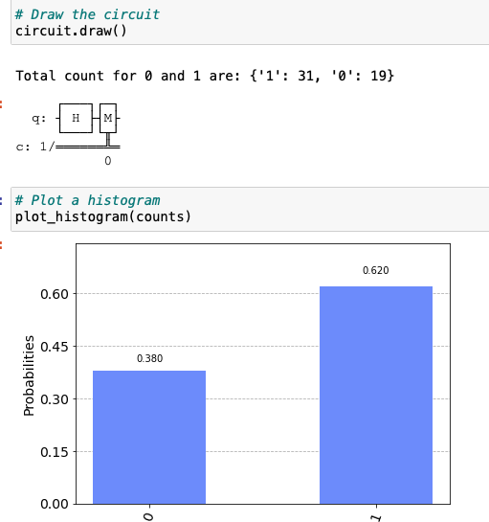
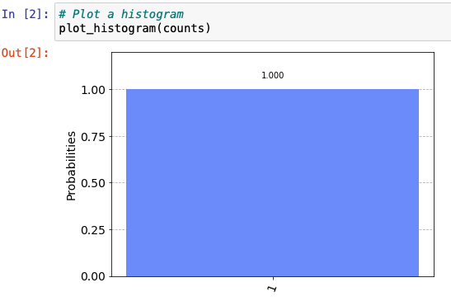
Step 6: Visualize the Results
Use the function plot_histogram, to view your results.
X gate with shots = 1000
H gate with shots = 50

Slide 39
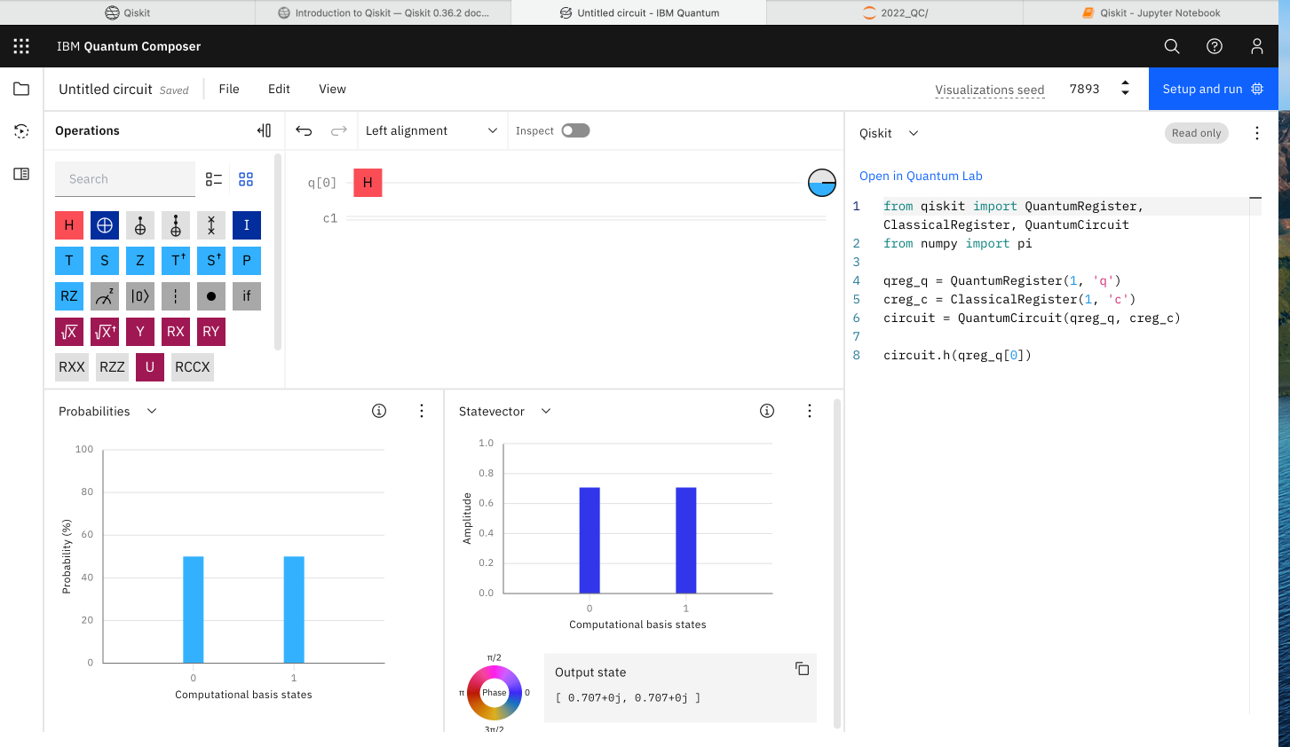
IBM Quantum Composer
Statevector
Probabilities
Notes:
Use statevector to describe the state of system vector.

Slide 40
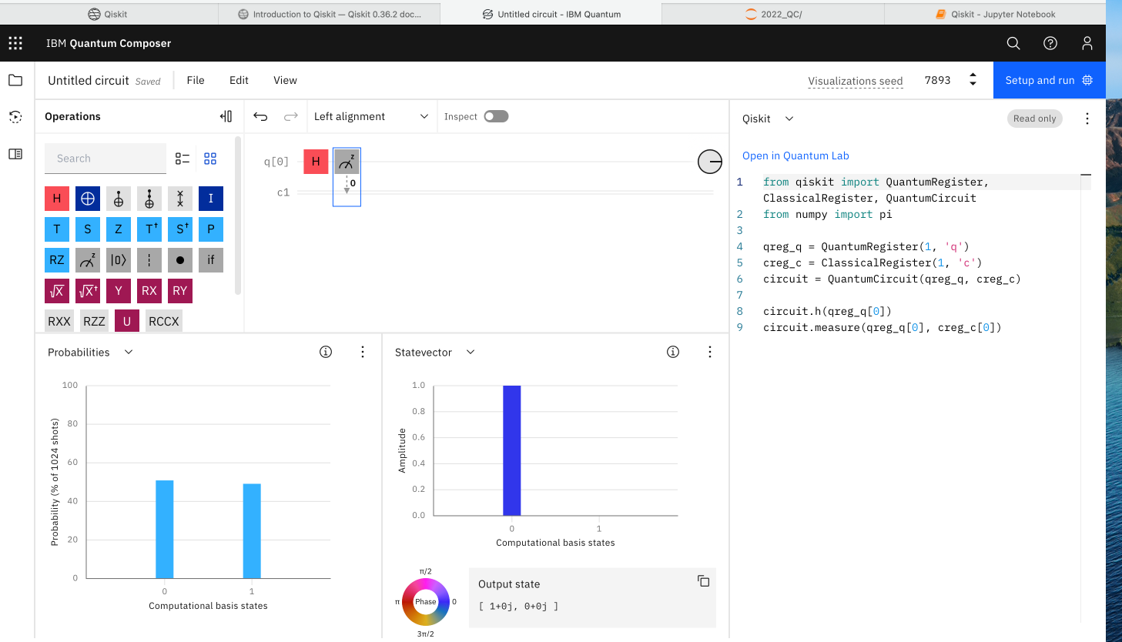
Measurement

Slide 41
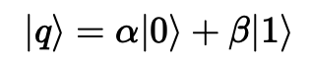
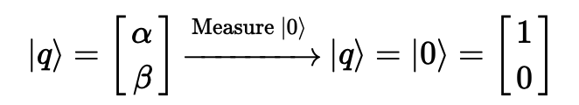
The Observer Effect
We know that the amplitudes contain information about the probability of us finding the qubit in a specific state, but once we have measured the qubit, we know with certainty what the state of the qubit is. For example, if we measure a qubit in the state:
And find it in the state |0⟩, if we measure again, there is a 100% chance of finding the qubit in the state |0⟩. This means the act of measuring changes the state of our qubits.

Slide 42
We sometimes refer to this as collapsing the state of the qubit.
Measuring a qubit collapses its superposition state into one of two possibilities.
Measurements are only used when we need to extract an output. This means that we often place all the measurements at the end of our quantum circuit.
https://qiskit.org/textbook/ch-states/representing-qubit-states.html#2.-The-Rules-of-Measurement-

Slide 43
Properties of Quantum Computing

Slide 44

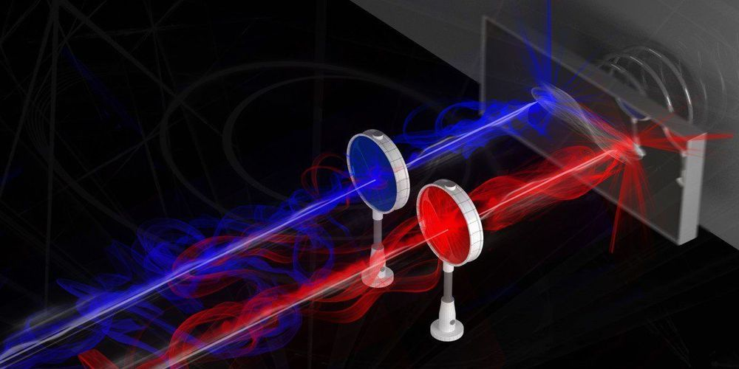
Basic Properties of Quantum Computing
Superposition
Entanglement
Interference
Notes:
When we observe the coin, we are making a measurement which destroys the superposition.

Slide 45
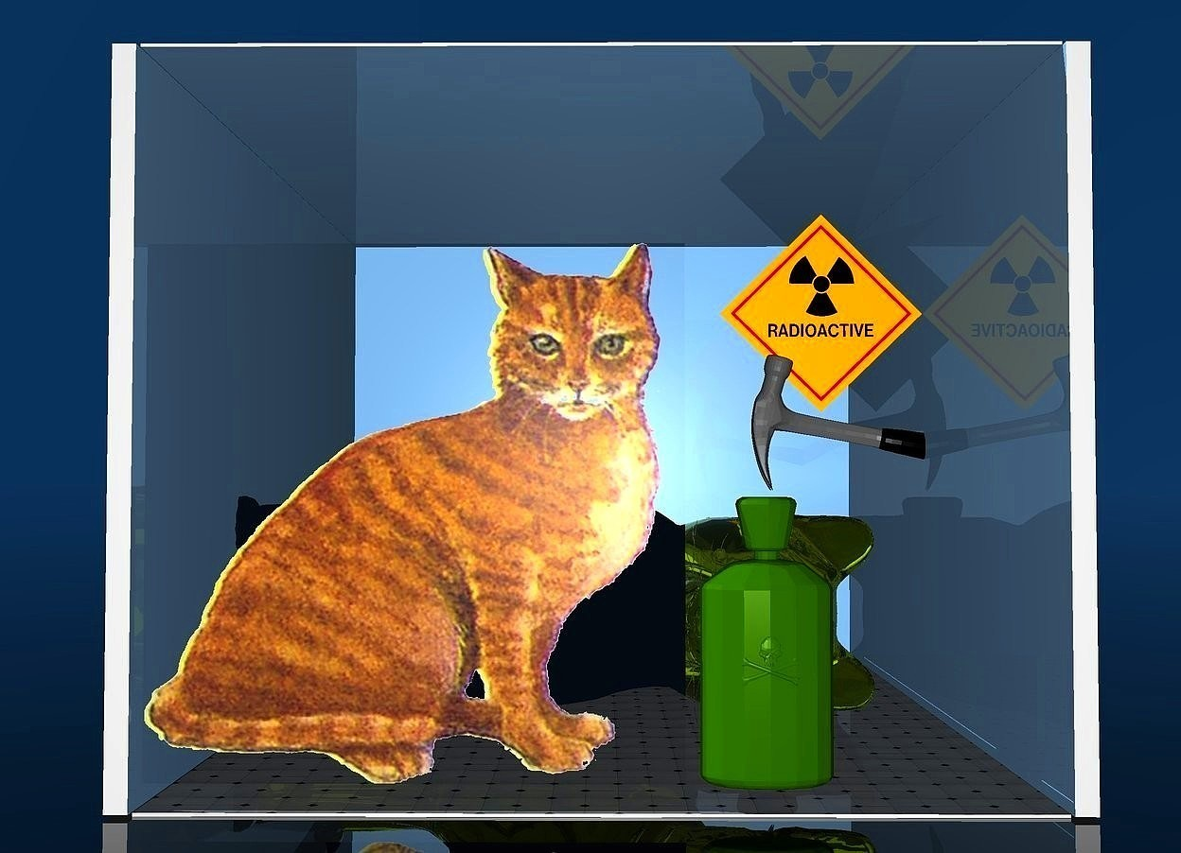
Superposition
while the coin is being flipped it is in a state of superposition.
1. A particle in a quantum superposition exists as a combination of different states at the same time.
2. Each possible state has a given probability of being observed, but measurement destroys the superposition because only one definite state is seen.
Quantum systems can exist in a superposition state and measuring the system will collapse the superposition state into one definite classical state.
Notes:
When we observe the coin, we are making a measurement which destroys the superposition.

Slide 46

Interference
Interference is essentially an energy redistribution process.
In physics, interference is a phenomenon in which two waves combine by adding their displacement together at every single point in space and time, to form a resultant wave of greater, lower, or the same amplitude.
Crest and trough in a wave
Notes:
A crest point on a wave is the maximum value of upward displacement within a cycle.
A trough is the opposite of a crest, so the minimum or lowest point in a cycle.

Slide 47

Constructive interference: If a crest of a wave meets a crest of another wave of the same frequency at the same point, then the amplitude is the sum of the individual amplitudes
Destructive interference: If a crest of one wave meets a trough of another wave, then the amplitude is equal to the difference in the individual amplitudes
Examples of constructive and destructive interference due to the classical superposition principle

Slide 48

How is interference utilized in quantum computation?
A classical analog: noise cancellation
When the phase difference is close to an odd multiple of π, the superposition of the two waves results in interference, and an output that is significantly reduced compared to the original.
The result is the signal of interest unencumbered by noise.
Approximate cancellation of a noise signal by a tone of nearly equal amplitude and offset by a phase of ∼π.

Slide 49

Quantum computation as an interference generation process.
To begin, one prepares a superposition of all possible computation states.
This is then used as an input to a quantum circuit that selectively interferes the components of the superposition according to a prescribed algorithm.
What remains after cancelling the relative amplitudes and phases of the input state is the solution to the computation performed by the quantum circuit.
Notes:
A general computation on a quantum computer proceeds in very much the same way as noise cancellation.

Slide 50

Entanglement
Entanglement
Quantum entanglement is a physical phenomenon that occurs when multiple qubits are correlated with each other.
Flip Two fair coins
HH, HT, TH, or TT. Each occurring with a 25% probability.
If we flipped a “entangled” pair of coins, they are entangled in such a way that only two measurement outcomes are possible:
both coins land on heads; or
both coins land on tails;
Each outcome occurring with 50% probability. We would never see HT or TH!

Slide 51
“Spooky action at a distance” - Einstein
Spooky action at a distance
If the two entangled coins are separated by thousands of miles, one coin can be flipped and measured. In this case, if the measured coin produced the outcome heads, then we automatically know that the other coin must also land on heads.
If the measured coin produced the outcome tails, then we automatically know that the other coin must also land of tails!
It has since been shown that no information is being transmitted from one place to the other, and so no information is being transmitted faster than the speed of light.

Slide 52

Spooky action at a distance
If the two coins are flipped at the exact same time, somehow the two coins know to land on the same side as the other even though there can be no classical communication between them.
The correlation between entangled qubits is the key that allows quantum computers to perform certain computations much faster than classical computers.
Two coins are separated with no means of communication between each other. Classically, the flip of the second coin would be unrelated to the first flip. However, entangled coins would still produce correlated results.

Slide 53


Controlled NOT (CNOT)
Flips the second (target) qubit and only if the first (control) qubit is |1>
The cx acts on two qubits, which are known as the ‘control’ and the ‘target’.
If the control is in state |0> , the cx does nothing;
If the control is in state |1>, the cx performs an x on the target qubit.
The CNOT is used to entangle two qubits together and is essential in quantum computing/algorithms.
Notes:
The cz is a gate whose effect is rather similar to the cx. It also acts on two qubits: the target and control.
It also does nothing when the control qubit is in state |0>. But for the control state |1>, it performs a z to the target.

Slide 54

Control - Target
The quantum circuit that sends a multi-qubit in the |01⟩ state through a CNOT gate.
IBM shorthand is top-down in circuit notation, which corresponds to right- left in bra-ket notation.

Slide 55

CNOT Circuit

Slide 56

Bell States
Bell states are the four states that can be created when two qubits are maximally entangled. The four states are represented as so:
https://quantumcomputinguk.org/tutorials/introduction-to-bell-states

Slide 57


Bell States
A quantum states of two qubits that represent the simplest (and maximal) examples of quantum entanglement.
Entangle State:
H gate + CNOT Gate
Notes:
Entangled states between qubits can be used for quantum teleportation,
where a shared entangled state of two qubits can be manipulated to transfer information from one qubit to another,
regardless of the relative physical proximity of the qubits
https://quantumcomputinguk.org/tutorials/introduction-to-bell-states

Slide 58

Entangled

Slide 59
Big Ideas
Entanglement is the sharing of non-classical information between two or more quantum states. This is caused by quantum states or qubits interacting with each other.
Entanglement is needed to make quantum computers perform calculations which classical computers cannot.
Two-qubit gates act on two different qubits simultaneously and creates entanglement. The controlled NOT (CNOT) gate is frequently used for this purpose.

Slide 60

Example

Slide 61


Slide 62


Slide 63
Quantum Teleportation

Slide 64
Quantum Teleportation
One interesting application of entanglement is quantum teleportation, which is a technique for transferring an unknown quantum state from one place to another.
The unitary condition ensures that all gates are reversible: we can undo the action of any gate by applying its conjugate transpose.
Notes:
conjugate transpose: 共轭转置

Slide 65


Goal:
Alice wants to send her (unknown) state |$Ψ$⟩s = α|0⟩ + β|1⟩ to Bob. She can only send him two classical bits through. They both share the maximally entangled state |$φ$⟩_{ΑΒ} = $\frac{1}{\sqrt{2}}$ (|00⟩ + |11⟩). The current situation is shown as below:

Slide 66

Alice interacts her two qubits using a CNOT gate (qubits S and A) and measures the qubit she originally had (qubit A). She then sends the unknown qubit to be teleported (qubit S) through a Hadamard gate and afterwards measures the output. Recall that the Hadamard gate is used to create a superposition of states.
Because Alice’s original qubit (qubit A) was entangled with Bob’s, the CNOT interaction with qubit S immediately changes the state of Bob’s qubit.

Slide 67
Mathematical description of this three-qubit protocol
Qubit S is the qubit to be teleported, and qubit A and B are the entangled pair shared by Alice and Bob. In ket notation, the three-qubit state is written in the order | S A B ⟩. In addition, the three-qubit state can be written in ket notation in different ways as long as the order of the qubits is kept unchanged.
For example, if qubit S = |0⟩, qubit A = |1⟩, and qubit B = |1⟩, they can be written as |S⟩|A⟩|B⟩ = |011⟩ = |0⟩|11⟩ = |01⟩|1⟩.

Slide 68

Step 1:
We have Alice and Bob’s qubits in the Bell state $\frac{1}{\sqrt{2}}$ (|00⟩ + |11⟩). Qubit S is in an unknown state α|0⟩ + β|1⟩.
The three qubits need to be written together in ket notation by multiplying the qubit to be teleported by the entangled Bell state. The product is:
α|0⟩ + β|1⟩ [$\frac{1}{\sqrt{2}}$ (|00⟩ + |11⟩)] = $\frac{1}{\sqrt{2}}$ (α|000⟩ + α|011⟩ + β|100⟩ + β|111⟩)
Next, we apply a CNOT gate using the first qubit in Eq. (8.2) as the control and the second as the target.
$\frac{1}{\sqrt{2}}$ (α|000⟩ + α|011⟩ + β|110⟩ + β|101⟩)

Slide 69

Step 2:
After this, we apply a Hadamard gate to qubit S, the three-qubit state is:
$\frac{1}{2}$ (α (|0⟩ + |1⟩) |00⟩ + α (|0⟩ + |1⟩) |11⟩ + β (|0⟩ - |1⟩) |10⟩ + β (|0⟩ - |1⟩) |01⟩)
Next, distribute the product of qubits throughout the above equation to find: $\frac{1}{2}$ (α |000⟩ + α |100⟩ + α |011⟩ + α |111⟩ + β |010⟩ - β |110⟩ + β|001⟩ - β |101⟩)

Slide 70

Step 3:
Combine like-terms based on the first two qubits to get
$\frac{1}{2}$ (|00⟩ (α |0⟩ + β |1⟩)
+ |10⟩ (α |0⟩ - β |1⟩)
+ |01⟩ (α |1⟩ + β |0⟩)
+ |11⟩ (α |1⟩ - β |0⟩))
Remember that qubit S and qubit A (the first two) are the ones that belong to Alice. We see that the state of Bob’s qubit B has changed by applying the CNOT and Hadamard gates to Alice’s qubits. As can be seen in the above equation, Bob’s qubit is currently in one of four possible superposition states.

Slide 71

Step 4:
Bob, on receiving the bits from Alice, knows he can obtain the original state |ψ⟩ by applying appropriate transformations on his qubit that was once part of the entangled pair.
The transformations he needs to apply are:
After this step Bob will have successfully reconstructed Alice's state.
Notes:
Depending on the measurement obtained by Alice, Bob can recover the original state of the teleported qubit (i.e., a|0⟩ + b|1⟩) by using a combination of X or Z gates.
At this stage, the qubit has been successfully teleported from Alice to Bob, and thus ends the teleportation protocol.

Slide 72

Throughout the teleportation process, the original qubit S that has to be teleported does not remain in its original quantum state: α |0⟩ + β |1⟩. This is because Alice performs a measurement on it during the teleportation protocol.
As a result, there is no copy of qubit S existing at any time, and so teleportation does not contradict the no-cloning theorem. It is important to understand that neither Alice nor Bob know what qubit S’s coefficients α or β are at any point in the process. All they know is that qubit S has been teleported from Alice to Bob. The full quantum teleportation circuit is illustrated as below:
Notes:
Figure: The full quantum circuit for quantum teleportation. The dashed box entangles Alice’s and Bob’s qubits to make the Bell state. Afterwards, the quantum teleportation protocol described in the text is performed.

Slide 73


Slide 74


Slide 75


Slide 76


Slide 77

Notes:
At the end of this protocol, Alice's qubit has now teleported to Bob.

Slide 78
Big Ideas
If Alice and Bob have a single qubit each, which they entangle, it is possible for Alice to teleport the information encoded in a third unknown qubit into Bob’s qubit.
Quantum teleportation sends quantum information by using the entanglement and measurement properties of quantum mechanics.
Quantum teleportation does not destroy the qubit to be teleported (like in science fiction). It only transfers the information contained within the qubit without ever needing to know that information.

Slide 79
Quantum Algorithm

Slide 80
Deutsch-Jozsa Algorithm
Given a hidden Boolean function f, which takes as input a string of bits, and returns either 0 or 1, that is:
f({x₀, x₁, x₂, ...}) → 0 or 1 , where x_{n} is 0 or 1
The property of the given Boolean function is guaranteed to either be balanced or constant.
A constant function returns all 0’s or all 1’s for any input, while a balanced function returns 0’s for exactly half of all inputs and 1's for the other half.
Our task is to determine whether the given function is balanced or constant.
Notes:
The first example of a quantum algorithm that performs better than the best classical algorithm.
It showed that there can be advantages to using a quantum computer as a computational tool for a specific problem.

Slide 81
The Classical Solution
We have to check exactly half of all possible inputs plus one in order to be certain that f(x) is constant.
Since the total number of possible inputs is 2^{n}, this implies that we need
2^{n−1}+ 1 trial inputs to be certain that f(x) is constant in the worst case.

Slide 82

The Quantum Solution
Solve this problem after only one call to the function f(x)
Function f implemented as a quantum oracle, which maps the state
|x⟩ |y⟩ to |x⟩ | y ⊕ f(x)⟩,
where ⊕ is addition modulo 2 (exclusive OR gate).
Below is the generic circuit for the Deutsch-Jozsa algorithm.

Slide 83
1. Prepare two quantum registers. The first is an n-qubit register initialized to |0⟩, and the second is a one-qubit register initialized to |1⟩:
|ψ₀⟩=|0⟩^{⊗n}|1⟩

Slide 84

2. Apply a Hadamard gate to each qubit:
|ψ₁⟩ = $\frac{1}{\sqrt{2^{n+1}}}\sum_{x=0}^{2^{n}−1}{\text{|}\text{x}\text{⟩}}\text{(|0⟩ − |1⟩}\text{)}$

Slide 85

3. Apply the quantum oracle |x⟩|y⟩ to |x⟩ |y ⊕ f(x)⟩:
|ψ₂⟩ = $\frac{1}{\sqrt{2^{n+1}}}\sum_{x=0}^{2^{n}−1}{\text{|}\text{x}\text{⟩}}$(|f(x)⟩ − |1⊕f(x)⟩)
= $\frac{1}{\sqrt{2^{n+1}}}\sum_{x=0}^{2^{n}−1}{{(−1)}^{f(x)}}$|x⟩ (|0⟩ - |1⟩)
since for each x, f(x) is either 0 or 1.

Slide 86

4. At this point the second single qubit register may be ignored. Apply a H gate to each qubit in the first register:
|ψ₃⟩ = $\frac{1}{2^{n}}\sum_{x=0}^{2^{n}−1}{{(−1)}^{f(x)}}\left[\sum_{y=0}^{2^{n}−1}{{\left(−1\right)}^{x.y}}\text{|}\text{y}\text{⟩}\right]$
= $\frac{1}{2^{n}}\sum_{y=0}^{2^{n}−1}{\left[\sum_{x=0}^{2^{n}−1}{{\left(−1\right)}^{f\left(x\right)}{(−1)}^{x.y}}\right]}$ $\text{|}\text{y}\text{⟩}$
where x.y = x₀y₀ ⊕ x₁y₁ ⊕ … ⊕ x_{n-1}y_{n-1} is the sum of the bitwise product.

Slide 87

5. Measure the first register. Notice that the probability of measuring
|0⟩^{⊗n} = | $\frac{1}{2^{n}} \sum_{x=0}^{2^{n}−1}{{(−1)}^{f(x)}\text{|}2}$,
which evaluates to 1 if f(x) is constant and 0 if f(x) is balanced.

Slide 88

Deutsch-Jozsa algorithm

Slide 89


Deutsch-Jozsa algorithm

Slide 90
Big Ideas
Although of little current practical use, the Deutsch-Jozsa algorithm is one of the first examples of a quantum algorithm that is exponentially faster than any possible deterministic classical algorithm.
Quantum computer will eventually do computations that are too difficult for conventional computer.

